Slide 1
Creating a Pie Chart
Ryan, Mitch, Paige
Darmody Period 7

Slide 2
Identifying information
When you have your information, you shall first select the cells containing the information.
Then you will go to the Insert tab and choose dropdown box with the title, Pie.

Slide 3
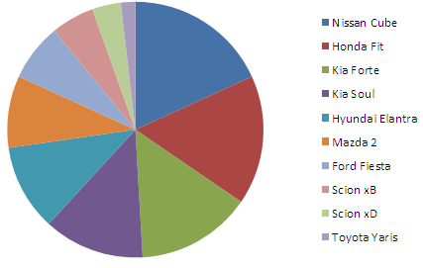
Formatting the Chart
When you have your pie chart made, many formatting tools are available for tweaking your pie chart.
For example, you can change the style and the layout of the chart and also move the chart to different spreadsheets.

Slide 4
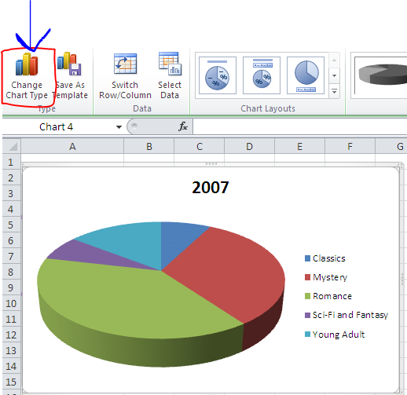
Changing the chart type
When you have a chart that does not show your data well and would like to switch the kind of chart, You must select the chart then click the Change Chart button and choose your desired design.

Slide 5
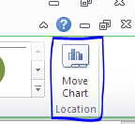
Moving Chart to a new page
When you decide you want your chart to be on a separate page from the rest of your data, the only thing you have to do is select the chart and click “Move Chart”
When prompted, just click “New Page” and type the desired title for the sheet

